Slide 1

Tour Price Prediction Model Using Linear Regression
Searching for an appropriate dataset. Eliminating unnecessary columns. Generating flags and categorical columns. Cleansing the data of missing values and NaNs. Replacing missing entries with zeros. Utilizing filters for data processing.

Slide 2

Introduction Project Goal: To develop a model for predicting the total cost of a tour based on various factors such as tour duration, season, hotel rating, room category, number of tourists, and more. This model will use linear regression to predict tour costs, helping travel agencies and operators to more accurately estimate and set tour prices.
https://github.com/mitiay001/Tour_Price_Pr_LR.git

Slide 3
Why is this important?:
The travel market is highly competitive, and accurate tour price estimation is crucial for attracting customers and increasing profits.
Travel agencies and operators need to understand which factors influence tour prices in order to optimize their offerings.
Predicting tour prices helps agencies adjust pricing strategies and predict profitability in advance.

Slide 4
2. Data Description The model is built using tour data that includes information on the following parameters: Tour Duration: The number of days tourists spend on the trip. Season: The time of year the tour takes place (e.g., summer, winter, high season, or low season). Hotel Rating: The rating of the hotel on a travel platform. Room Category: The type of room at the hotel (e.g., standard, suite). Number of Tourists: The number of people in the group. Additional Service Costs: Extra expenses such as excursions, meals, etc. Transportation Costs: Transfer and airfare costs. Geographic Features: The destination country and region. This data is presented in a table format with both numerical and categorical features.

Slide 5
Let's analyze this DataFrame.

Slide 6
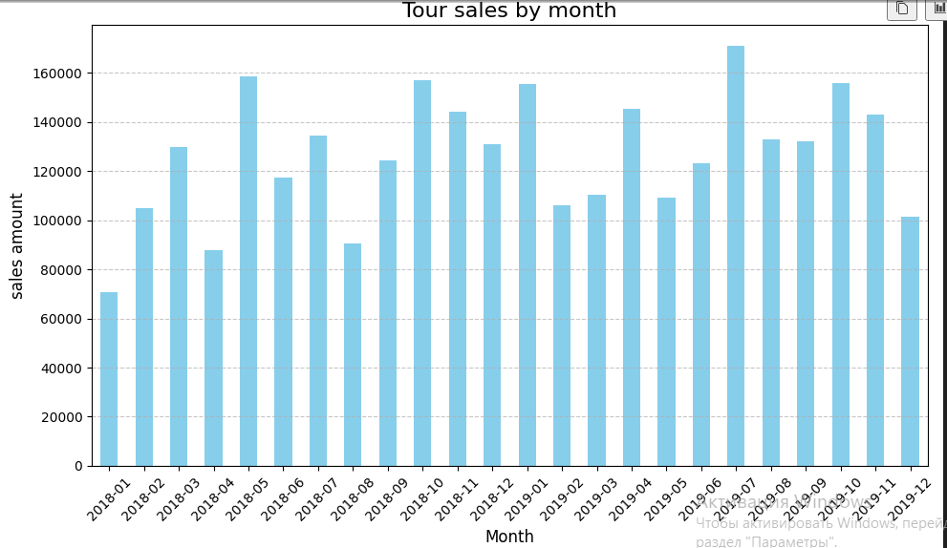
5. Visualisation

Slide 7
In this chart, we can see the sales of the tour operator from January 2018 to December 2019, broken down by months. The chart shows no systematic changes in sales volumes. The graph appears organic. The minimum value is in January 2018, which is entirely reasonable.

Slide 8
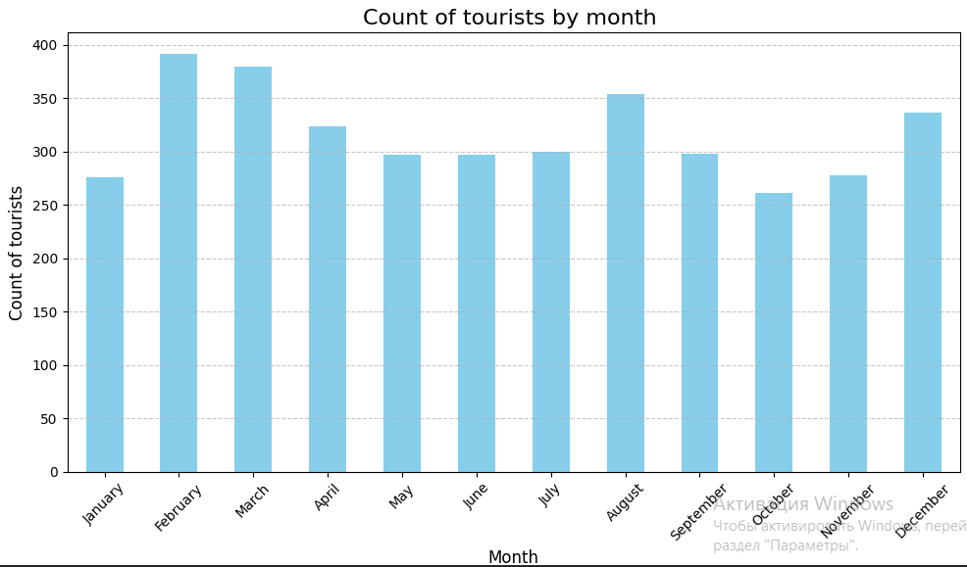
3. Linear Regression Method Description Linear regression is a method that allows us to predict a dependent variable (tour price) based on one or more independent variables (factors such as tour duration, season, number of tourists, etc.). Main Idea: The linear regression model attempts to find coefficients that minimize the prediction error based on the training data. The formula for predicting the tour price will look like this: Tour Price=b0+b1×Duration+b2×Season+b3×Hotel Rating… Where: b0​ - is the intercept, b1,b2,b3,… -are the coefficients for each feature that determine its contribution to the overall price.

Slide 9
This chart shows the number of pax visiting Thailand, broken down by months. We can see a slight increase in February and March, approximately 15-20%.

Slide 10
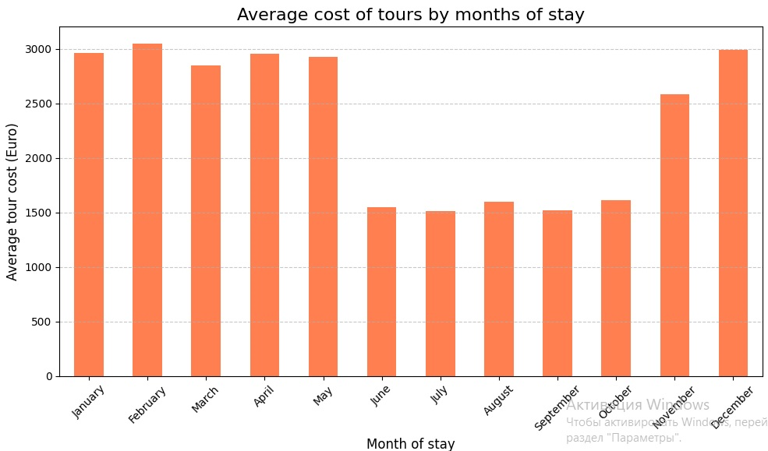
3. Linear Regression Method Description Linear regression is a method that allows us to predict a dependent variable (tour price) based on one or more independent variables (factors such as tour duration, season, number of tourists, etc.). Main Idea: The linear regression model attempts to find coefficients that minimize the prediction error based on the training data. The formula for predicting the tour price will look like this: Tour Price=b0+b1×Duration+b2×Season+b3×Hotel Rating… Where: b0​ - is the intercept, b1,b2,b3,… -are the coefficients for each feature that determine its contribution to the overall price.

Slide 11
In this chart, we analyze the average cost of tours to Thailand over the course of the tourist year, broken down by months. It clearly shows seasonality and a price drop from June to October.

Slide 12
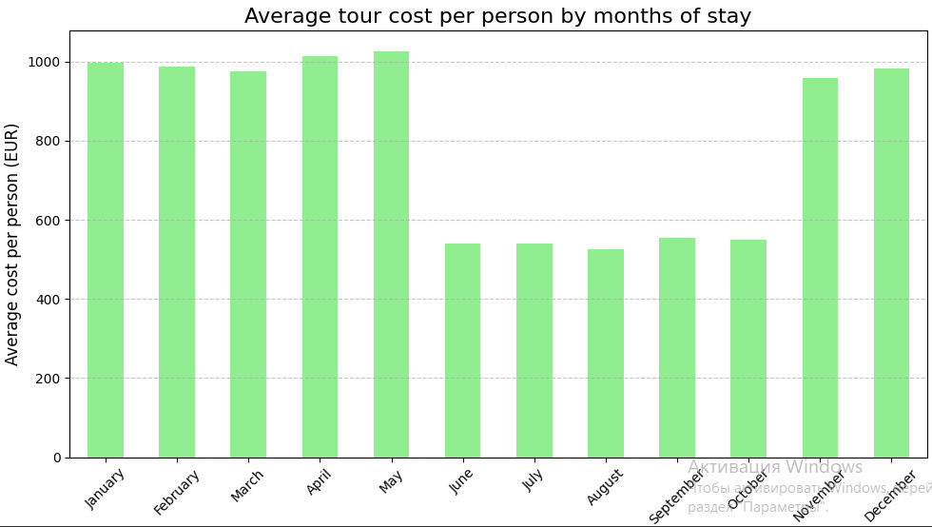
3. Linear Regression Method Description Linear regression is a method that allows us to predict a dependent variable (tour price) based on one or more independent variables (factors such as tour duration, season, number of tourists, etc.). Main Idea: The linear regression model attempts to find coefficients that minimize the prediction error based on the training data. The formula for predicting the tour price will look like this: Tour Price=b0+b1×Duration+b2×Season+b3×Hotel Rating… Where: b0​ - is the intercept, b1,b2,b3,… -are the coefficients for each feature that determine its contribution to the overall price.

Slide 13
In this chart, we analyze the cost per person for tours to Thailand over the course of the tourist year, also broken down by months. We observe a pronounced seasonality with prices dropping from June to October. During this period, the price is approximately 500 euros per person, while in the remaining months, it is around 1,000 euros.

Slide 14
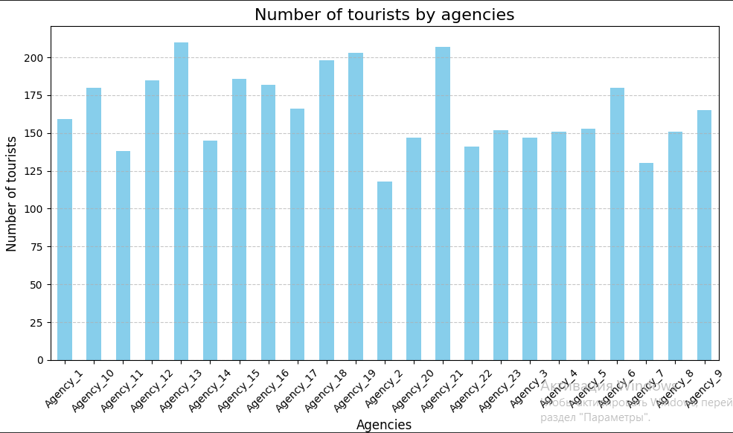
3. Linear Regression Method Description Linear regression is a method that allows us to predict a dependent variable (tour price) based on one or more independent variables (factors such as tour duration, season, number of tourists, etc.). Main Idea: The linear regression model attempts to find coefficients that minimize the prediction error based on the training data. The formula for predicting the tour price will look like this: Tour Price=b0+b1×Duration+b2×Season+b3×Hotel Rating… Where: b0​ - is the intercept, b1,b2,b3,… -are the coefficients for each feature that determine its contribution to the overall price.

Slide 15
n this chart, we analyze the productivity of the partner network in terms of the number of tourists sent. The minimum value is seen for Agency #2, with about 115 tourists. Agencies #13 and #21 show the highest performance, with over 200 tourists each.

Slide 16
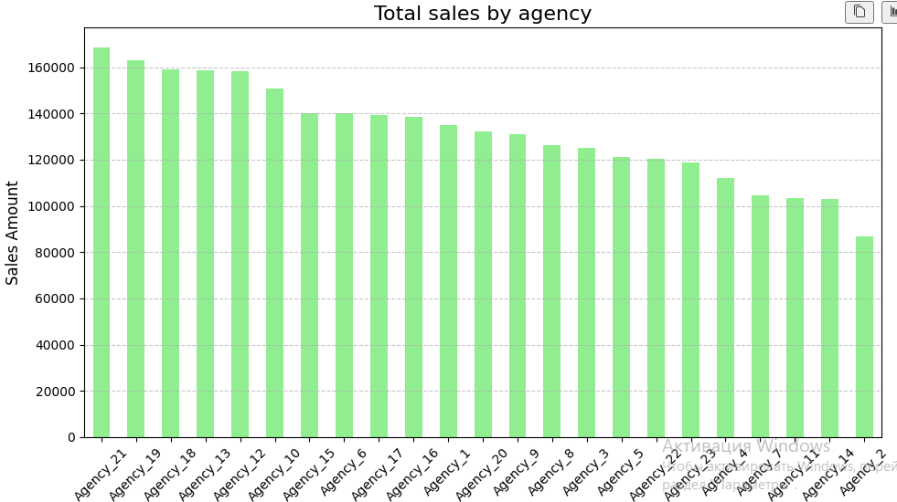
3. Linear Regression Method Description Linear regression is a method that allows us to predict a dependent variable (tour price) based on one or more independent variables (factors such as tour duration, season, number of tourists, etc.). Main Idea: The linear regression model attempts to find coefficients that minimize the prediction error based on the training data. The formula for predicting the tour price will look like this: Tour Price=b0+b1×Duration+b2×Season+b3×Hotel Rating… Where: b0​ - is the intercept, b1,b2,b3,… -are the coefficients for each feature that determine its contribution to the overall price.

Slide 17
Here we also continue analyzing the productivity of the partner network, this time in monetary terms. The highest sales are from Agency #21, exceeding 160,000 euros for the period, while the lowest are from Agency #2, slightly over 80,000 euros.

Slide 18
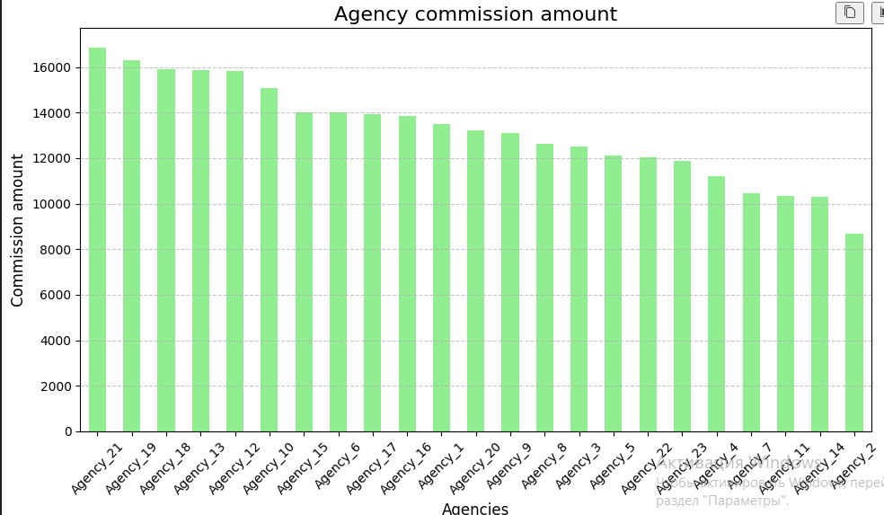
3. Linear Regression Method Description Linear regression is a method that allows us to predict a dependent variable (tour price) based on one or more independent variables (factors such as tour duration, season, number of tourists, etc.). Main Idea: The linear regression model attempts to find coefficients that minimize the prediction error based on the training data. The formula for predicting the tour price will look like this: Tour Price=b0+b1×Duration+b2×Season+b3×Hotel Rating… Where: b0​ - is the intercept, b1,b2,b3,… -are the coefficients for each feature that determine its contribution to the overall price.

Slide 19
Commission payouts are directly proportional to the previous slide. They range from 16,000 to 8,000.

Slide 20
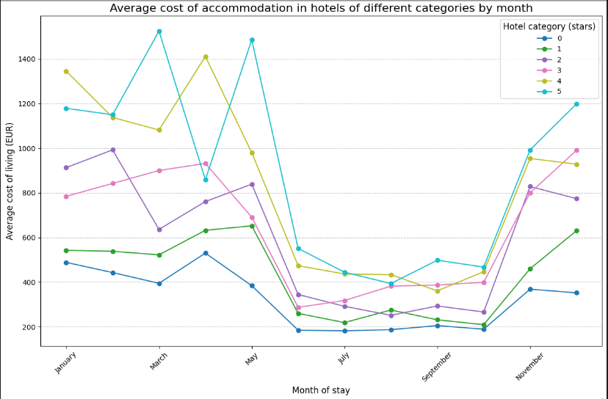
3. Linear Regression Method Description Linear regression is a method that allows us to predict a dependent variable (tour price) based on one or more independent variables (factors such as tour duration, season, number of tourists, etc.). Main Idea: The linear regression model attempts to find coefficients that minimize the prediction error based on the training data. The formula for predicting the tour price will look like this: Tour Price=b0+b1×Duration+b2×Season+b3×Hotel Rating… Where: b0​ - is the intercept, b1,b2,b3,… -are the coefficients for each feature that determine its contribution to the overall price.

Slide 21
In this chart, we analyze the cost of ground services for hotels within the tour package. The chart shows seasonality, with the data broken down by hotel categories, ranging from 0 to 5 stars.

Slide 22
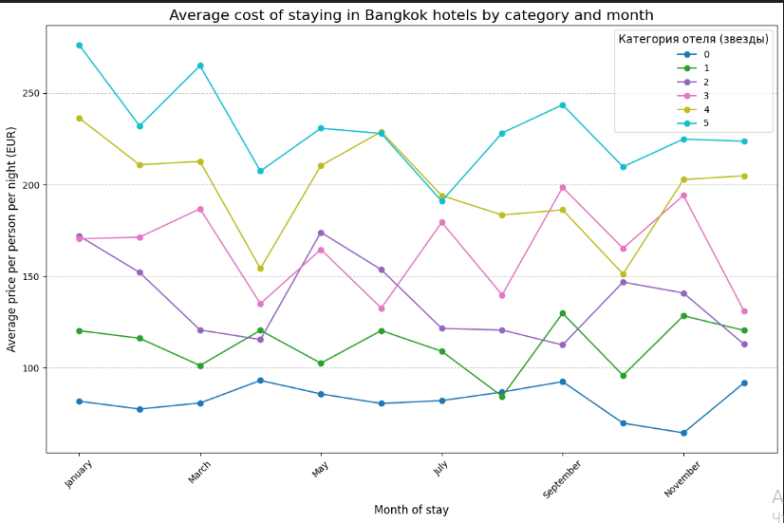
3. Linear Regression Method Description Linear regression is a method that allows us to predict a dependent variable (tour price) based on one or more independent variables (factors such as tour duration, season, number of tourists, etc.). Main Idea: The linear regression model attempts to find coefficients that minimize the prediction error based on the training data. The formula for predicting the tour price will look like this: Tour Price=b0+b1×Duration+b2×Season+b3×Hotel Rating… Where: b0​ - is the intercept, b1,b2,b3,… -are the coefficients for each feature that determine its contribution to the overall price.

Slide 23
Unlike the previous chart, we selected the segment for Bangkok. Here, we observe more linear prices without pronounced seasonality. The chart is also broken down by hotel categories and months.

Slide 24
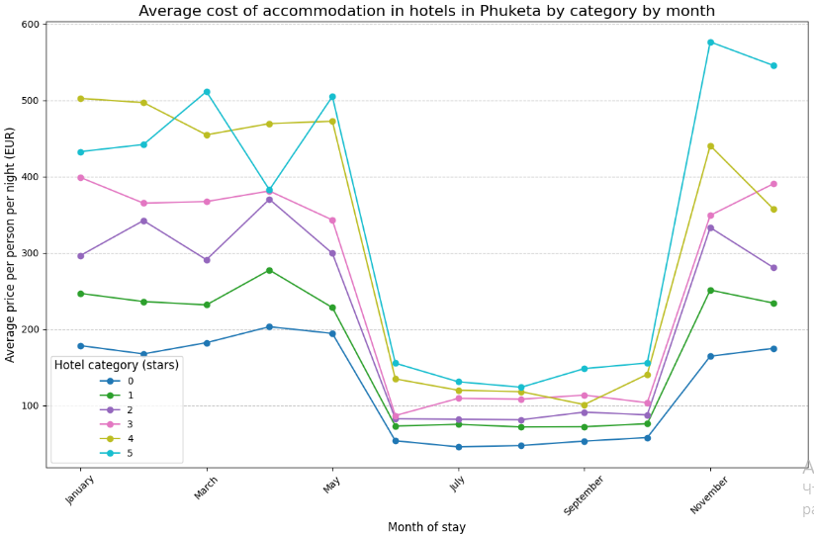
3. Linear Regression Method Description Linear regression is a method that allows us to predict a dependent variable (tour price) based on one or more independent variables (factors such as tour duration, season, number of tourists, etc.). Main Idea: The linear regression model attempts to find coefficients that minimize the prediction error based on the training data. The formula for predicting the tour price will look like this: Tour Price=b0+b1×Duration+b2×Season+b3×Hotel Rating… Where: b0​ - is the intercept, b1,b2,b3,… -are the coefficients for each feature that determine its contribution to the overall price.

Slide 25
In this chart, hotels in the Phuket segment are grouped by month. Unlike Bangkok, here we see a clear seasonality, with prices rising 2 to 3 times during the peak season.

Slide 26
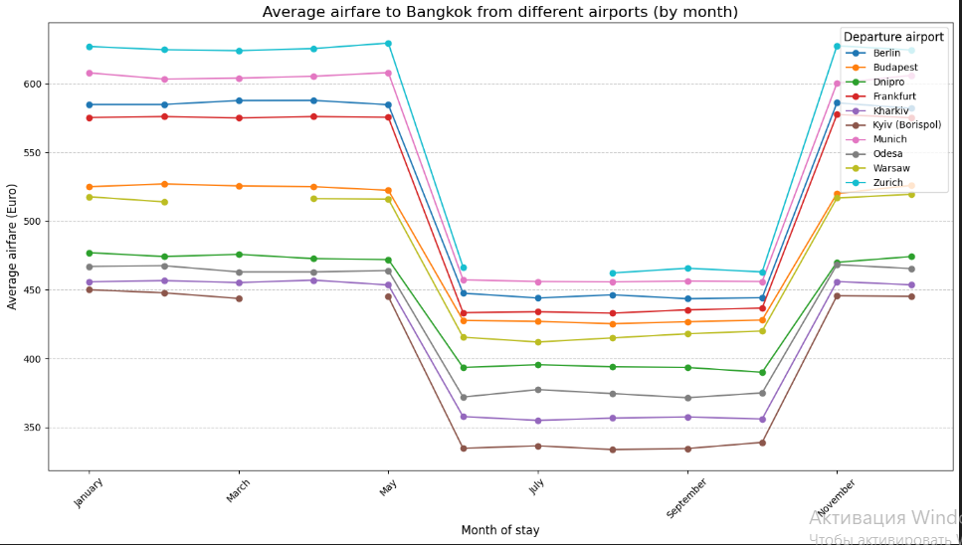
3. Linear Regression Method Description Linear regression is a method that allows us to predict a dependent variable (tour price) based on one or more independent variables (factors such as tour duration, season, number of tourists, etc.). Main Idea: The linear regression model attempts to find coefficients that minimize the prediction error based on the training data. The formula for predicting the tour price will look like this: Tour Price=b0+b1×Duration+b2×Season+b3×Hotel Rating… Where: b0​ - is the intercept, b1,b2,b3,… -are the coefficients for each feature that determine its contribution to the overall price.

Slide 27
In this chart, we analyze the cost of a flight ticket for one tourist to Bangkok. The chart shows seasonality, and it is also broken down by airports. We can see that Zurich is the most expensive airport, while Kiev is the cheapest.

Slide 28
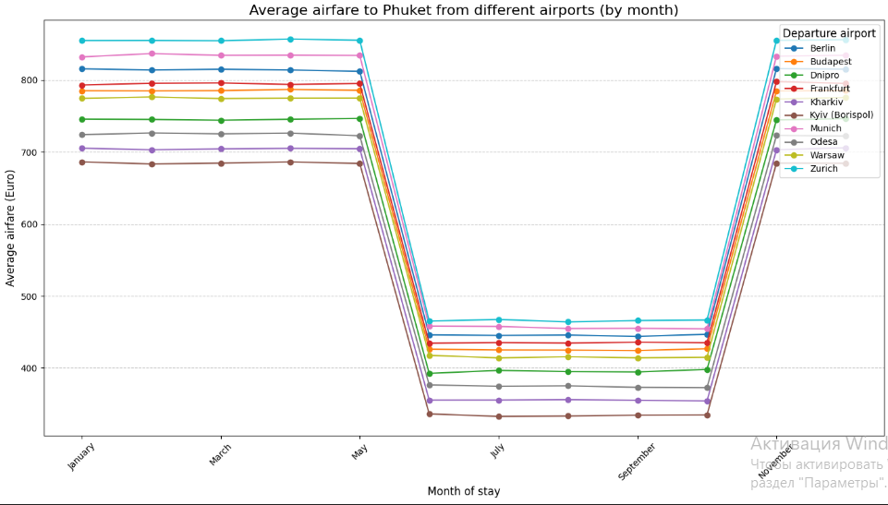
3. Linear Regression Method Description Linear regression is a method that allows us to predict a dependent variable (tour price) based on one or more independent variables (factors such as tour duration, season, number of tourists, etc.). Main Idea: The linear regression model attempts to find coefficients that minimize the prediction error based on the training data. The formula for predicting the tour price will look like this: Tour Price=b0+b1×Duration+b2×Season+b3×Hotel Rating… Where: b0​ - is the intercept, b1,b2,b3,… -are the coefficients for each feature that determine its contribution to the overall price.

Slide 29
In this chart, we also analyze the cost of a flight ticket for one tourist to Phuket. We observe a very pronounced seasonality, with significantly lower prices during the off-season. The chart is also broken down by airports. The cheapest airport is Kiev, while Zurich is the most expensive.

Slide 30
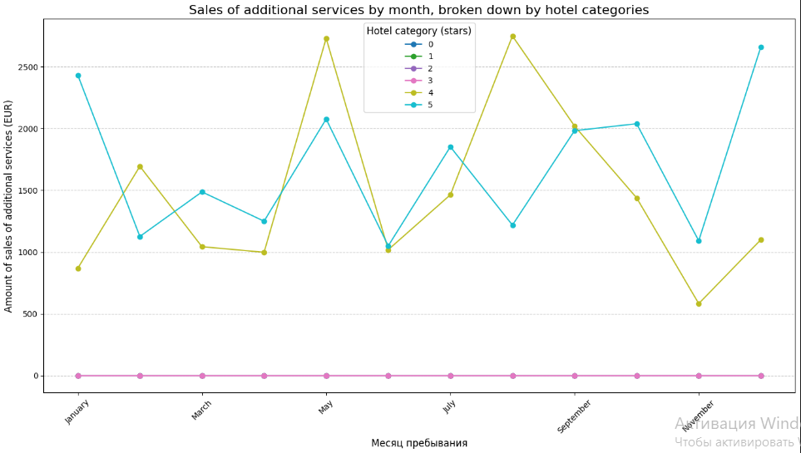
3. Linear Regression Method Description Linear regression is a method that allows us to predict a dependent variable (tour price) based on one or more independent variables (factors such as tour duration, season, number of tourists, etc.). Main Idea: The linear regression model attempts to find coefficients that minimize the prediction error based on the training data. The formula for predicting the tour price will look like this: Tour Price=b0+b1×Duration+b2×Season+b3×Hotel Rating… Where: b0​ - is the intercept, b1,b2,b3,… -are the coefficients for each feature that determine its contribution to the overall price.

Slide 31
In this chart, we analyzed which segment of tourists purchases additional services, where the highest earnings are generated. The chart shows that only visitors of 4 and 5-star hotels purchased additional services.

Slide 32
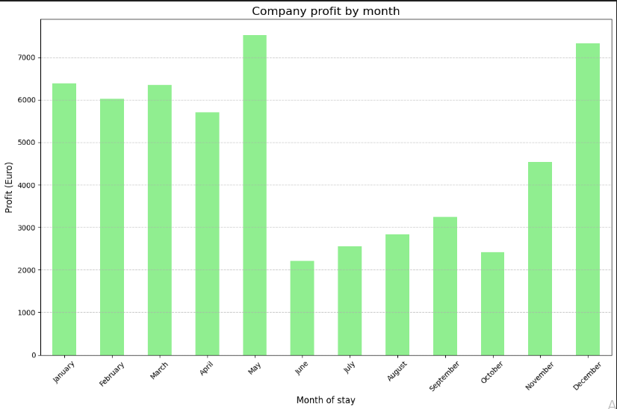
3. Linear Regression Method Description Linear regression is a method that allows us to predict a dependent variable (tour price) based on one or more independent variables (factors such as tour duration, season, number of tourists, etc.). Main Idea: The linear regression model attempts to find coefficients that minimize the prediction error based on the training data. The formula for predicting the tour price will look like this: Tour Price=b0+b1×Duration+b2×Season+b3×Hotel Rating… Where: b0​ - is the intercept, b1,b2,b3,… -are the coefficients for each feature that determine its contribution to the overall price.

Slide 33
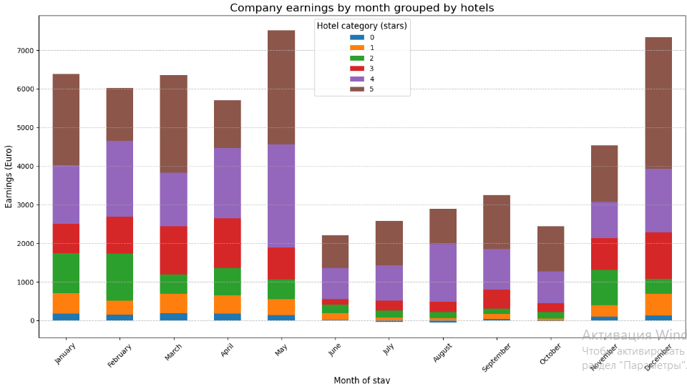
3. Linear Regression Method Description Linear regression is a method that allows us to predict a dependent variable (tour price) based on one or more independent variables (factors such as tour duration, season, number of tourists, etc.). Main Idea: The linear regression model attempts to find coefficients that minimize the prediction error based on the training data. The formula for predicting the tour price will look like this: Tour Price=b0+b1×Duration+b2×Season+b3×Hotel Rating… Where: b0​ - is the intercept, b1,b2,b3,… -are the coefficients for each feature that determine its contribution to the overall price.

Slide 34
In this chart, we analyzed that the highest earnings come from the sale of more expensive tours, such as those to 4 or 5-star hotels. Additionally, sales are significantly higher during the peak season.

Slide 35
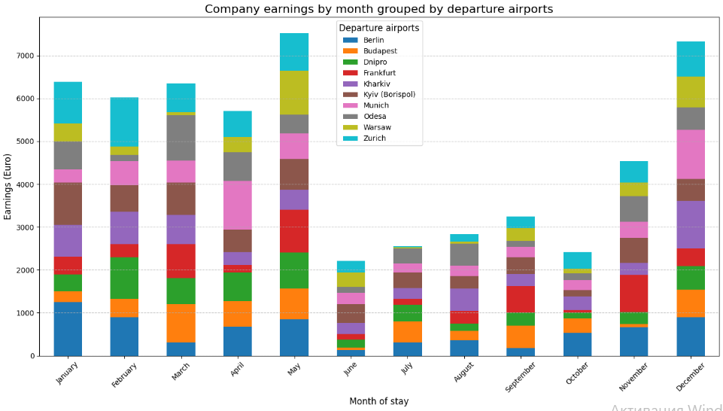
3. Linear Regression Method Description Linear regression is a method that allows us to predict a dependent variable (tour price) based on one or more independent variables (factors such as tour duration, season, number of tourists, etc.). Main Idea: The linear regression model attempts to find coefficients that minimize the prediction error based on the training data. The formula for predicting the tour price will look like this: Tour Price=b0+b1×Duration+b2×Season+b3×Hotel Rating… Where: b0​ - is the intercept, b1,b2,b3,… -are the coefficients for each feature that determine its contribution to the overall price.

Slide 36
This chart shows the company's earnings broken down by regions. We can see that Zurich and Warsaw are the most profitable, making them strong candidates for scaling up.

Slide 37
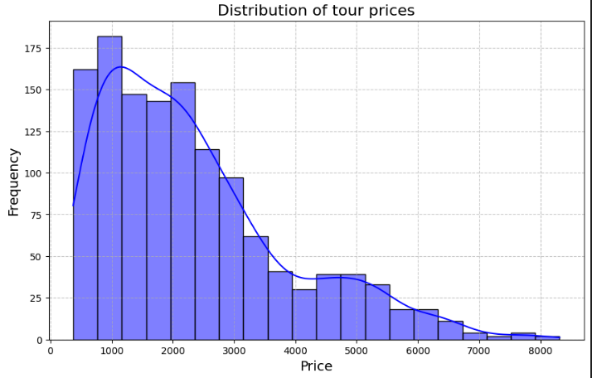

Slide 38
This histogram shows the frequency distribution of prices. We can see that the price range from 1000 to 2500 euros is the most popular.

Slide 39
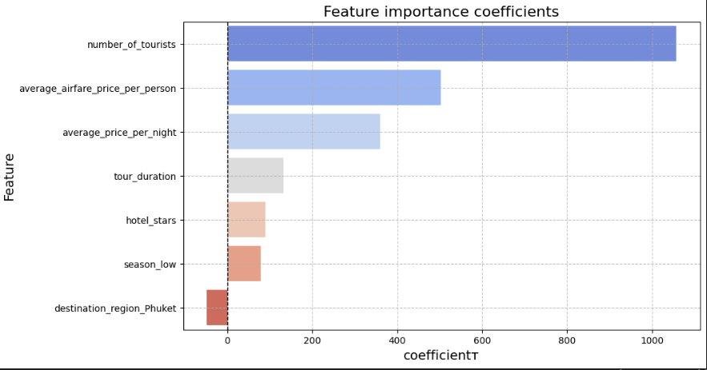

Slide 40
This chart visualizes which variables have the greatest impact on the target variable. The variables AVERAGE AIRFARE and AVERAGE PRICE were generated through Feature Engineering, which significantly improved the model's performance.

Slide 41
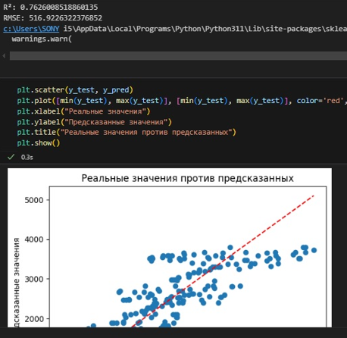
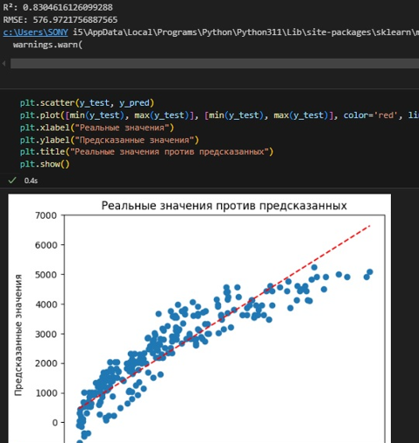
How it was : 1- 0,76 & 516 . 2- 0,83 & 576. 3- …..

Slide 42
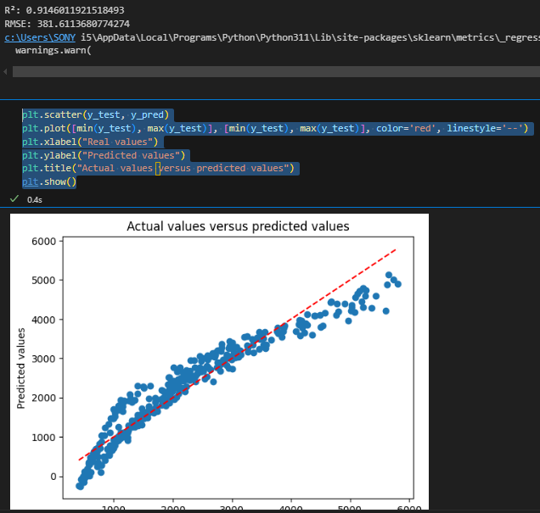
In the case of dynamic nonlinear pricing, the accuracy of our model is R² = 0.914 and RMSE = 381. However, if the model is switched to linear pricing, the accuracy improves significantly, with R² = 0.99 and RMSE around 40. This demonstrates a strong correlation and much lower error in predictions under linear pricing conditions.

Slide 43
Thank you all for your attention! Have a good evening!

